Slide 1
The application of ML in the field of Network security
邵政道 PB17061287,szd549845545@mail.ustc.edu.cn
汪书畅 PB17071369,wangsc014@mail.ustc.edu.cn
May.10th.2020

Slide 2
Content
Introduction
Detect attacks based on network structure destruction
Practical project of intrusion detection algorithm for KDD CUP99
Spam recognition algorithm based on Ling-spam dataset and naive Bayesian algorithm
Some new ideas && Summary

Slide 3
Introduction
1
·The difference between ML and human brain
·Three main uses of machine learning[1]
·Introduction to common open data sets in machine learning
·Security problem abstraction of machine learning[4]
·Effectiveness evaluation index in security field[4]

Slide 4
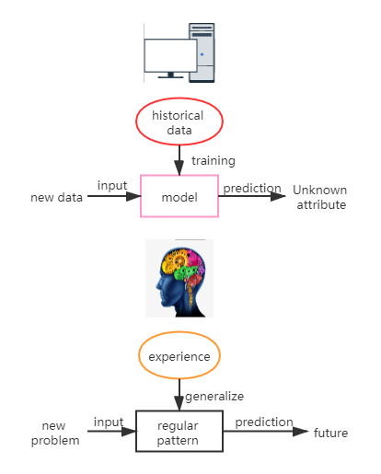
The difference between ML and human brain
"training"
"prediction"
in machine learning
"induction" "speculation"
of human beings.

Slide 5

Three main uses of machine learning[1]
In terms of malicious code and malware identification
On social workers' security
In Intrusion Detection

Slide 6
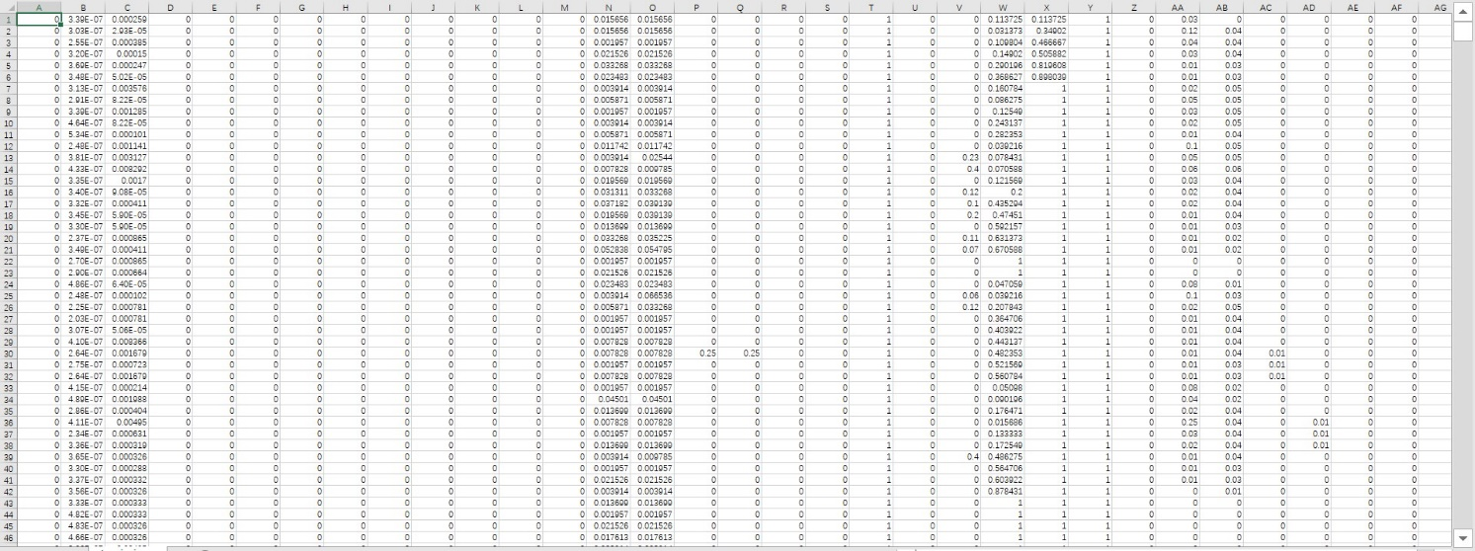
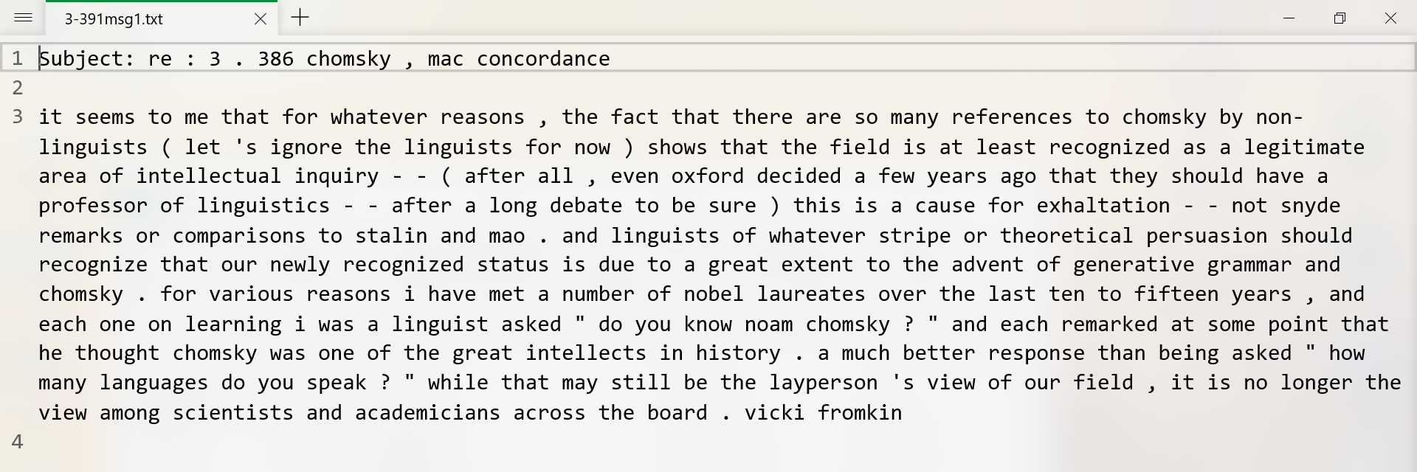
Introduction to common open data sets in machine learning
KDD99 [2]
NSL KDD
NASA MDP
Ling-Spam dataset[3]
……

Slide 7
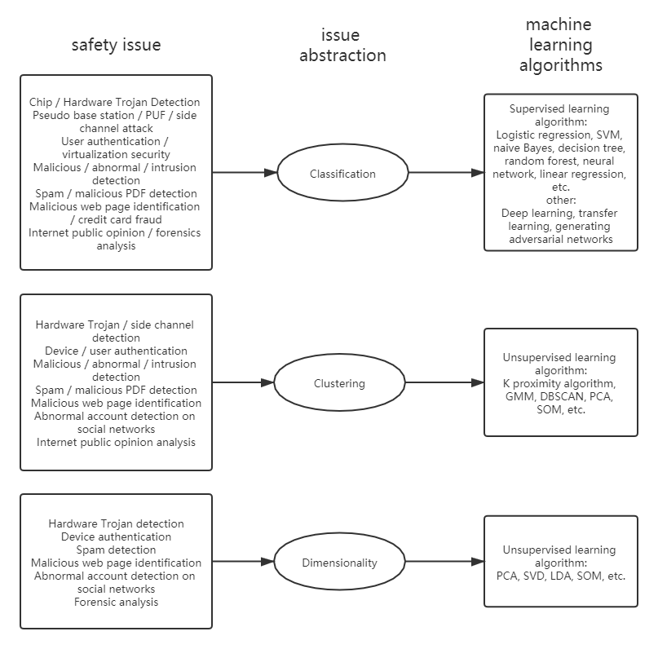
Security problem abstraction of machine learning[4]
Safety issue
Issue abstraction
Machine learning algorithms

Slide 8
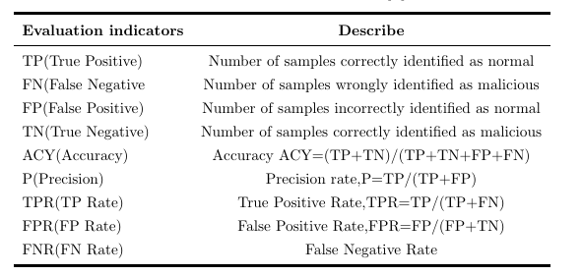
Effectiveness evaluation index in security field[4]

Slide 9
Detect attacks based on network structure destruction
2

Slide 10
Introduction of the project
The main idea comes from the paper Machine Learning-Based Link Fault Identification and Localization in Complex Networks[5].
The passive monitoring method is used to solve the problem of identifying and locating link faults in complex networks.
A machine learning model has been developed to learn traffic behavior under normal operating conditions and under different link faults.

Slide 11

What we’ve got from the paper
We can experience through actual operation, and we can compare it with active monitoring.
Learn the author's method of preprocessing data, and learn and record the modeling method.

Slide 12
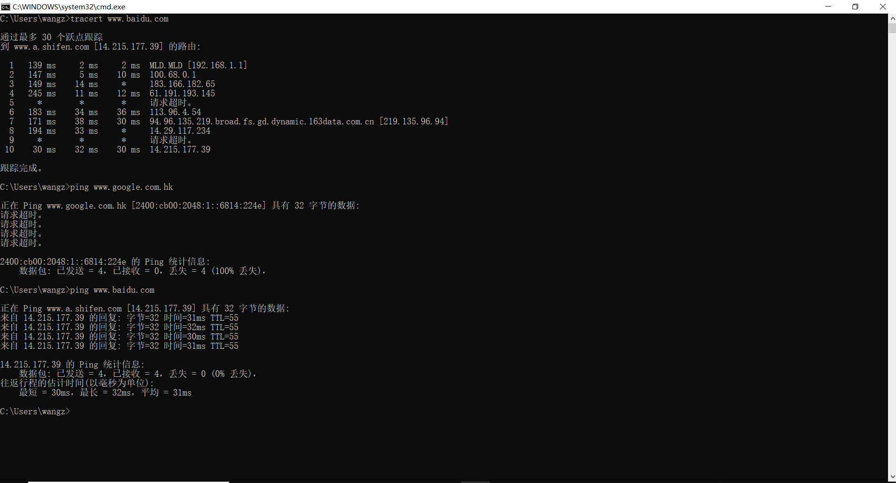
Feature extraction
Total transmission rate
End-to-end delay
Packet loss rate
空白版式

Slide 13
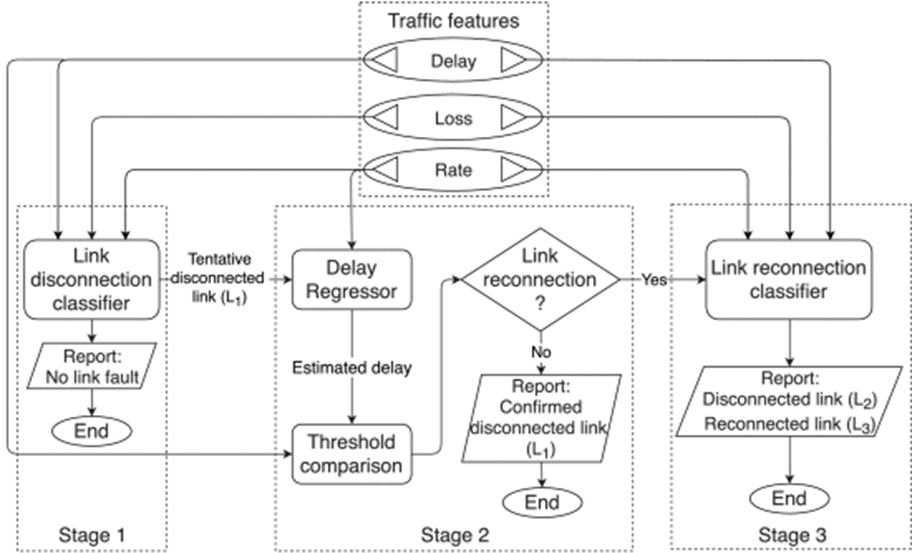
Three steps of ML-LFIL

Slide 14
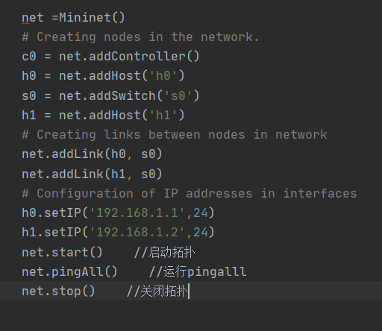
Our operations
Platform: Mininet
Wireshark
How to simulate link disconnection
the data is pre-processed using normalization techniques and principal component analysis (PCA)
This is a confirmatory experiment for us so the results is similar to those given in the paper itself.

Slide 15
Practical project of intrusion detection algorithm for KDD CUP99
3

Slide 16
Four categories of the data set
Basic characteristics of TCP connection
Content characteristics of TCP connections
Statistical characteristics of network traﬃc based on time
Statistical characteristics of network traﬃc based on host

Slide 17
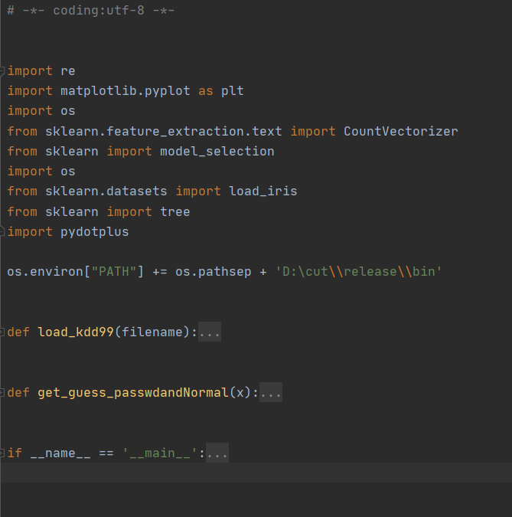
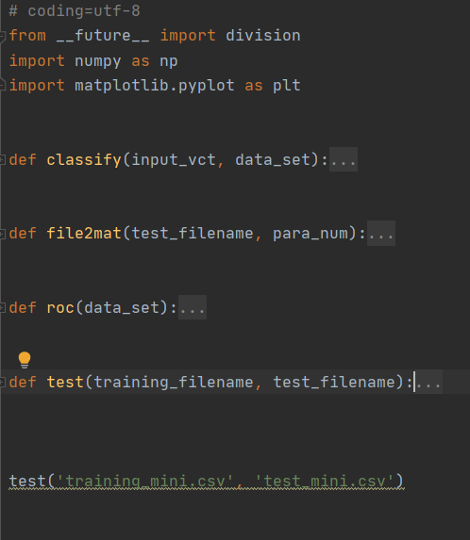
The structure of code[6]

Slide 18

Data pre-processing based on Tensorflow
Download data set (sk-learn neural network module)
Data preprocessing
(One-hot encoding)
Building a neural network hierarchy model
Training a classifier
Classify the data set

Slide 19
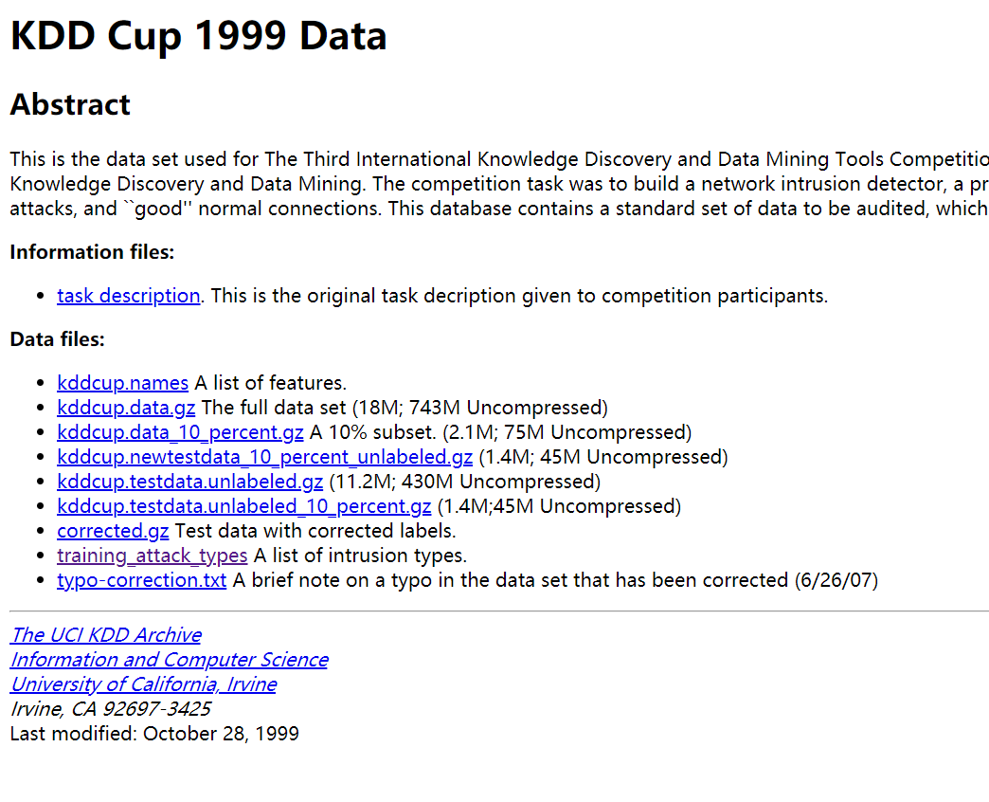
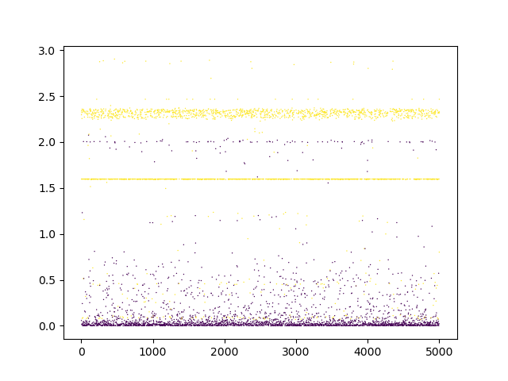
Results of the 10% dataset

Slide 20
Spam recognition algorithm based on Ling- spam dataset and naive Bayesian algorithm
4

Slide 21
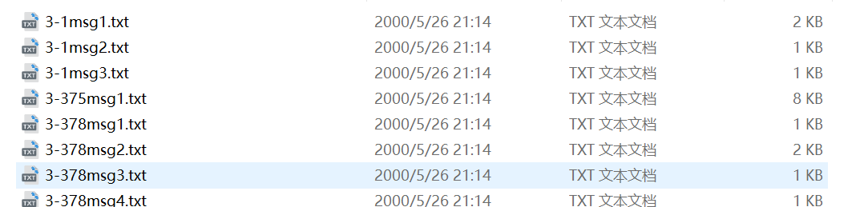
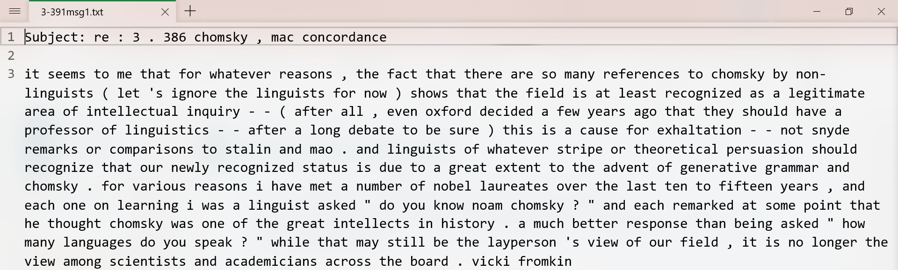
Data set introduction
350 emails of “nonspam train” and “spam train”
constitute a test set containing 130 spam messages and 130 non spam messages

Slide 22
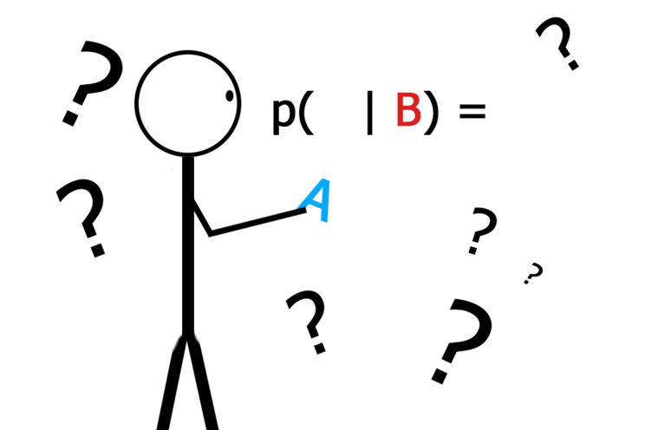
Training method based on Naive Bayes
Assuming that the properties are independent of each other when the target value is given
To some extent, it reduces the classification effect of Bayesian classification algorithm, but in the actual application scenario, it greatly simplifies the complexity of Bayesian method.

Slide 23
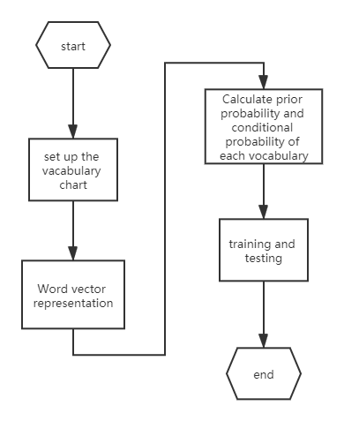
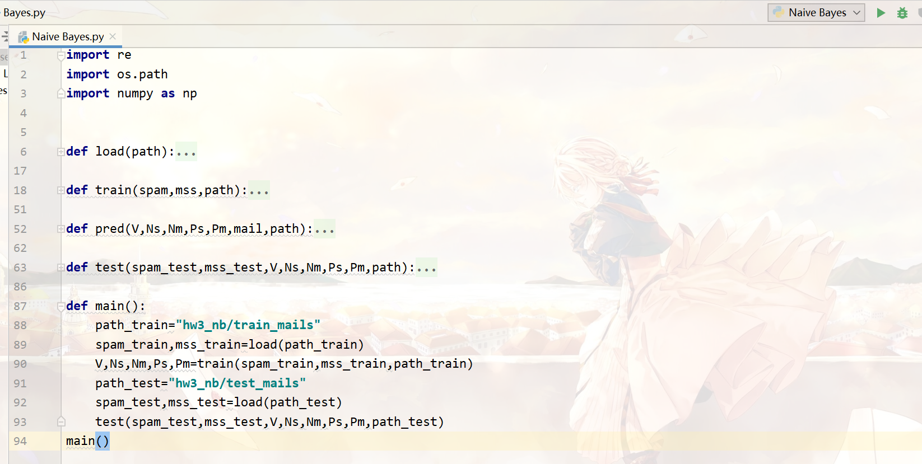
Program block diagram

Slide 24
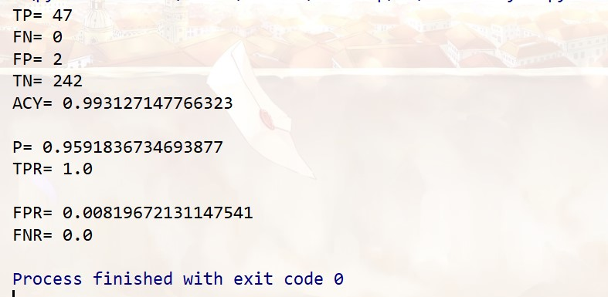
Results && Analysis
The training results show that the trained machine can distinguish
the spam with high efficiency.

Slide 25
Some ideas && Summary
5

Slide 26

Some ideas
Category imbalance
Noise
Problem summary of developing algorithm

Slide 27
Summary
Exercise of self ability
Reading
Coding
Writing
Some projects
ml-lfil (detecting attacks based on destroying network structure)
intrusion detection algorithm practice for KDD CUP99
spam recognition based on Ling spam dataset and naive Bayesian algorithm

Slide 28

Project division
Paper reading {A,B}
Paper writing {A,B}
Introduction {A}
Detect attacks based on network structure destruction
{B}
Practical project of intrusion detection algorithm for KDD CUP99
{B}
Spam recognition algorithm based on Ling-spam dataset and naive Bayesian algorithm
{A}
Some new ideas && Summary
{A,B}
Technical pictures {B}
Latex Typesetting {A}
A means 邵政道PB17061287
B means 汪书畅PB17071369

Slide 29
References :
[1] M. Zaman and C. Lung, "Evaluation of machine learning techniques for network intrusion detection", NOMS 2018 - 2018 IEEE/IFIP
[2] KDD Cup 99, http://kdd.ics.uci.edu/databases/kddcup99/kddcup99.html.
[3] http://csmining.org/index.php/ling-spam-datasets.html
[4]张蕾，崔勇，刘静，江勇，吴建平。机器学习在网络空间安全研究中的应用。计算机学报，清华大学计算机科学与技术系;北京邮电大学网络与交换技术国家重点实验室。2017。
[5] Srinikethan Madapuzi Srinivasan，Tram Truong-Huu，Mohan Gurusamy, Machine Learning-based Link Fault Identification and Localization in Complex Networks, 2018,10.1109/JIOT.2019.2908019
[6] https://github.com/gongyan200/kddcup99.git

Slide 30
Thank you for listening!

